Slide 1
2019 Rapid Response Conference

Slide 2
General Assembly

Slide 3
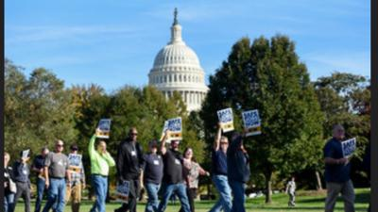
Workplace Violence Act

Slide 4
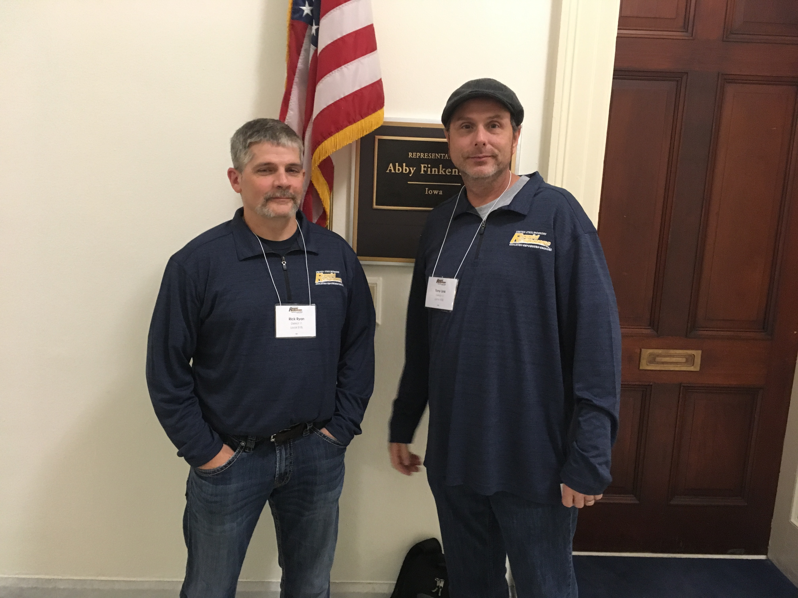
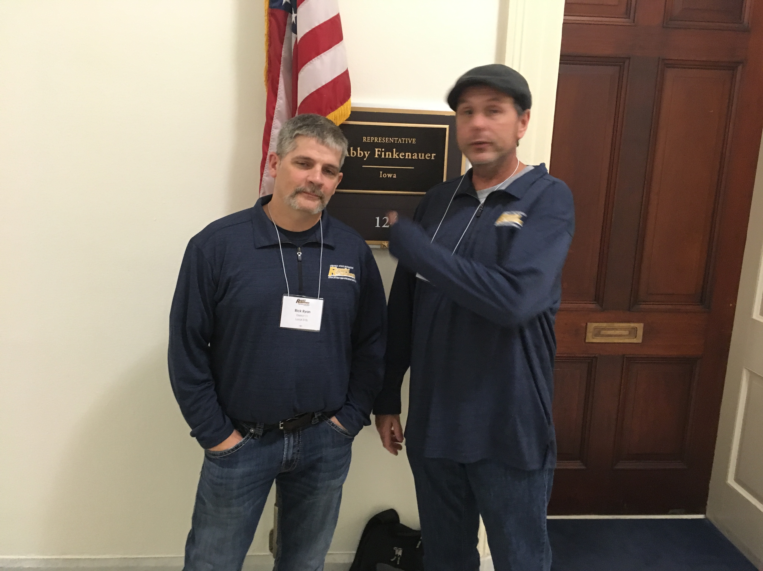
Renogotiated NAFTA – No vote on USMCA -
Rep Finkenauer

Slide 5
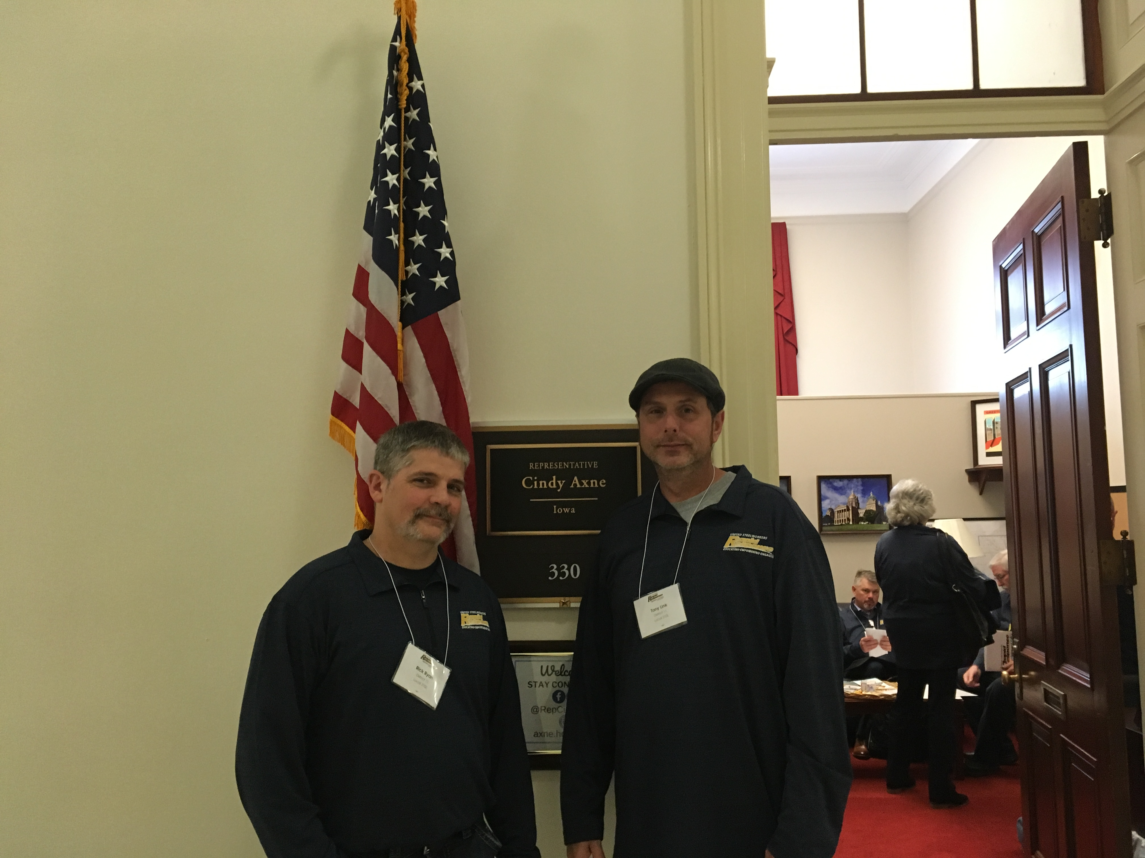
The PRO Act - Rep Axne

Slide 6
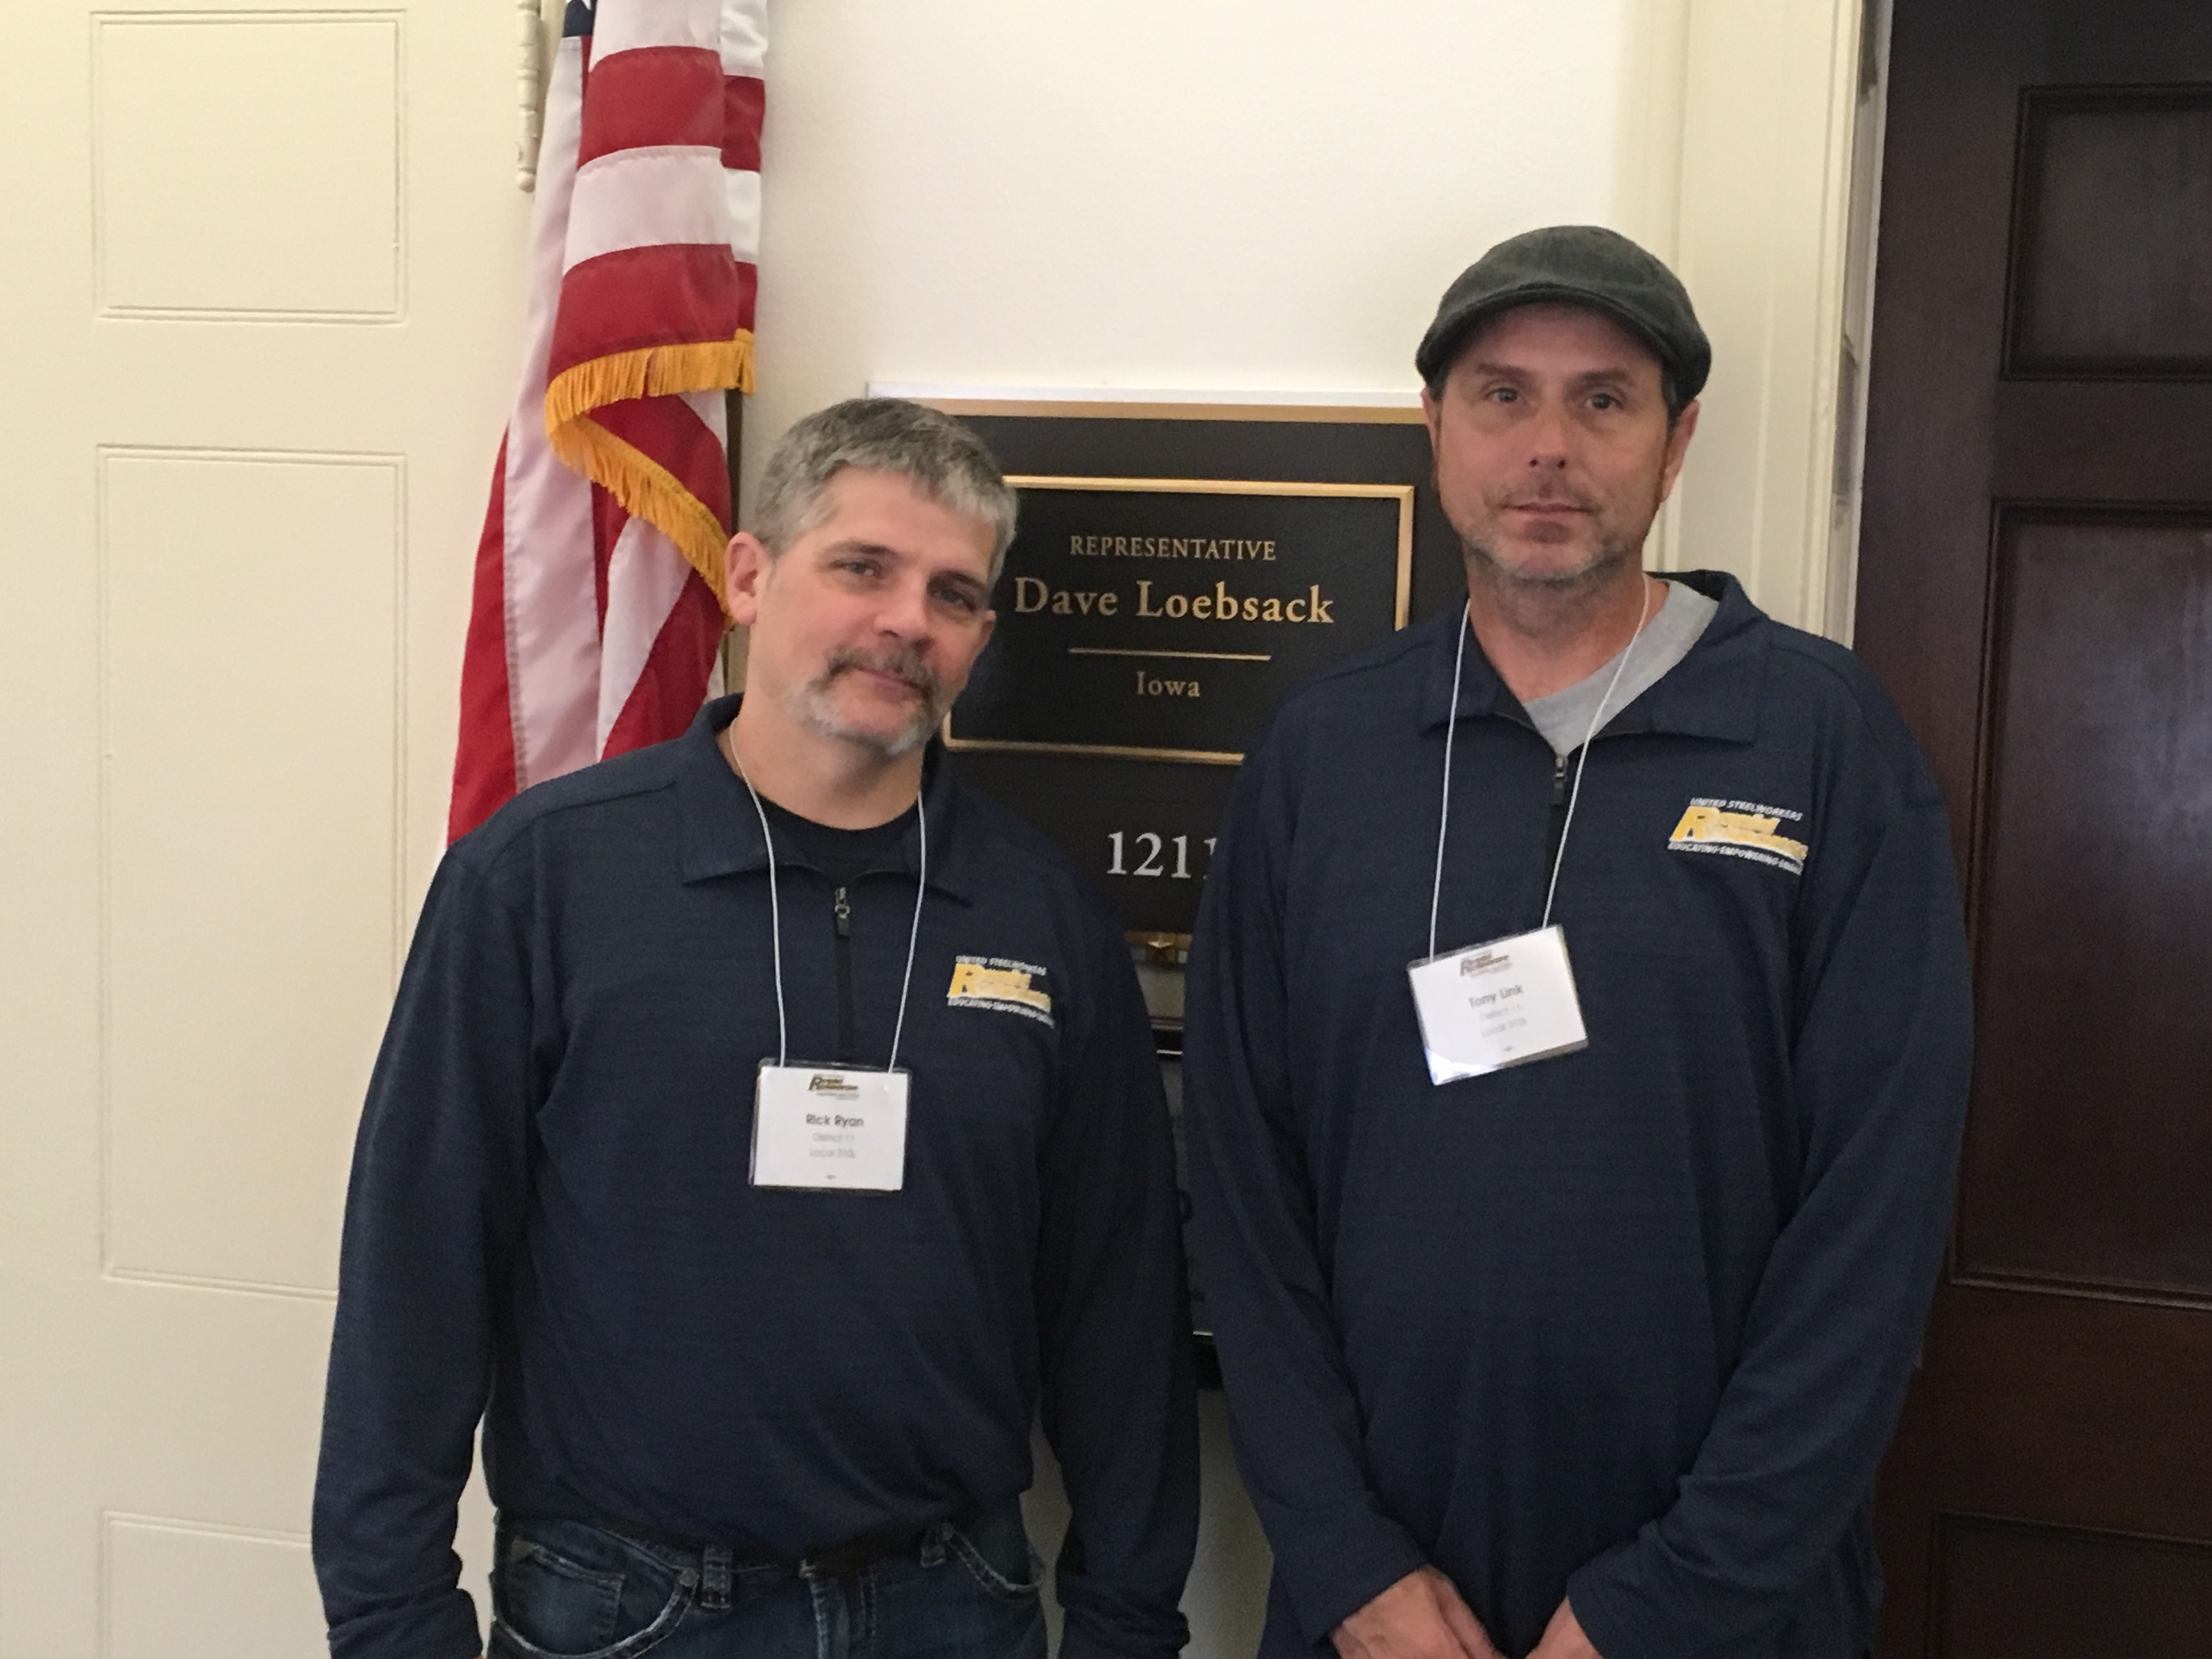
Butch Lewis Act - Rep Loebsack

Slide 7
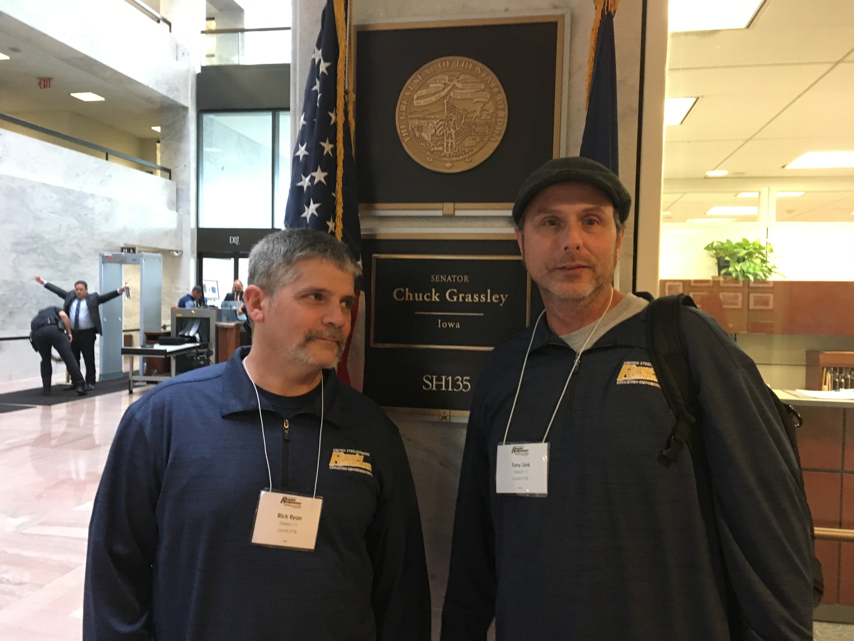
Senator Grassley met with us

Slide 8
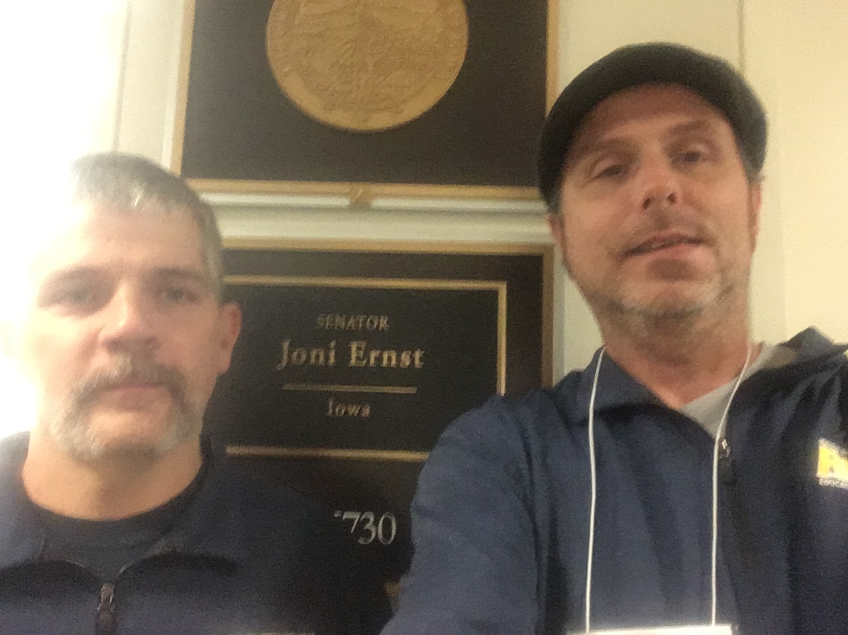
Senator Ernst did not meet with us in person

Slide 9
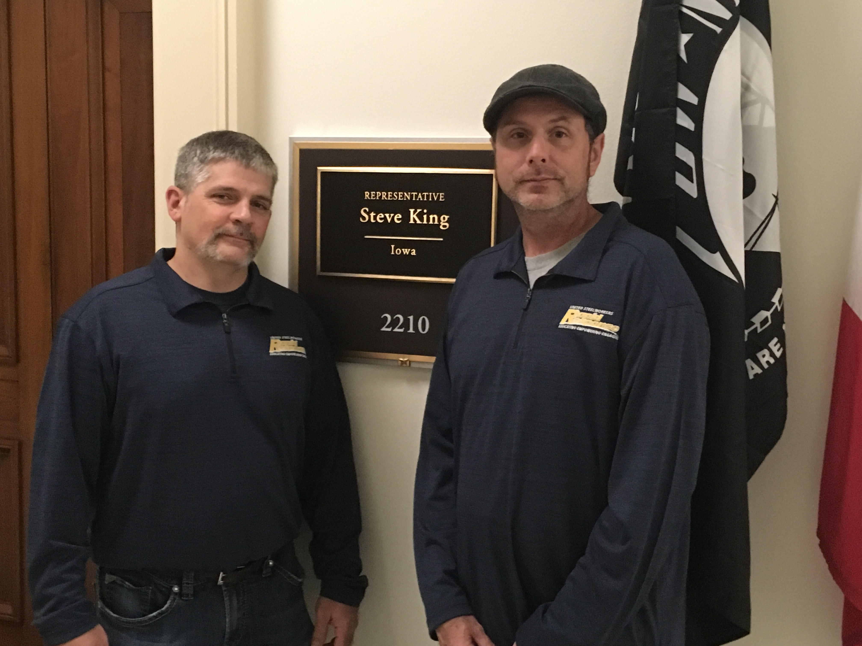
Representative King was very unhelpful

Slide 10
What Rapid Response does for YOU Butch Lewis Act

