Slide 1
2018 Rapid Response Conference: Washington D.C.
Tony Link
Dan Kelley

Slide 2
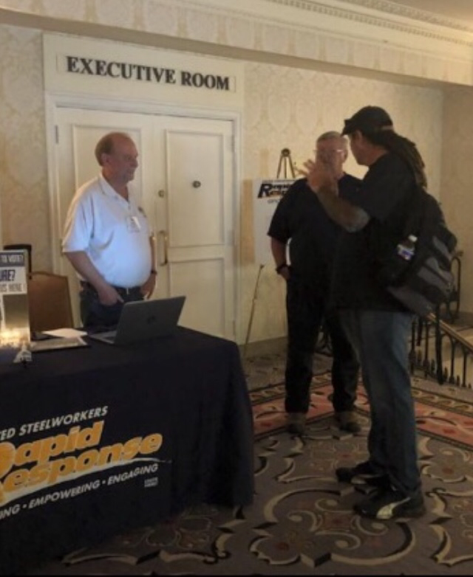
Registration Day
Tony and Dan registering at Omni Hotel with Bob Ryan, District 11 Rapid Response Director.

Slide 3
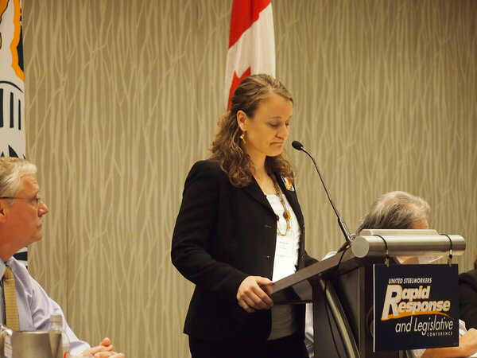
Kim Miller: Director, USW, Rapid Response
Explained that good policy in legislation is the way to protect labor, health care, safety, and human rights.

Slide 4
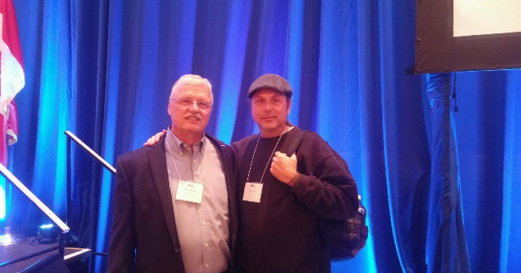
Stan Johnson: International Secretary-Treasurer
Explained how to stop the government from dismantling labor by people’s involvement, conversations, and bipartisanship.

Slide 5
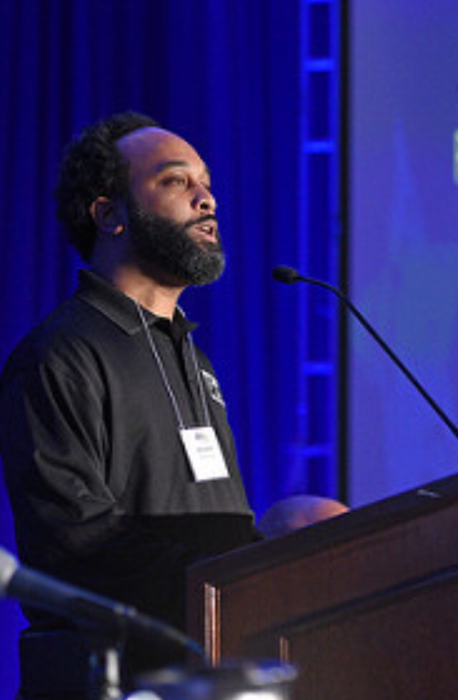
Alex Perkins: President, USW Local 572
Explained how he organized a non-union facility, and the struggles and hardships to get it done because of poor legislation against labor unions.

Slide 6
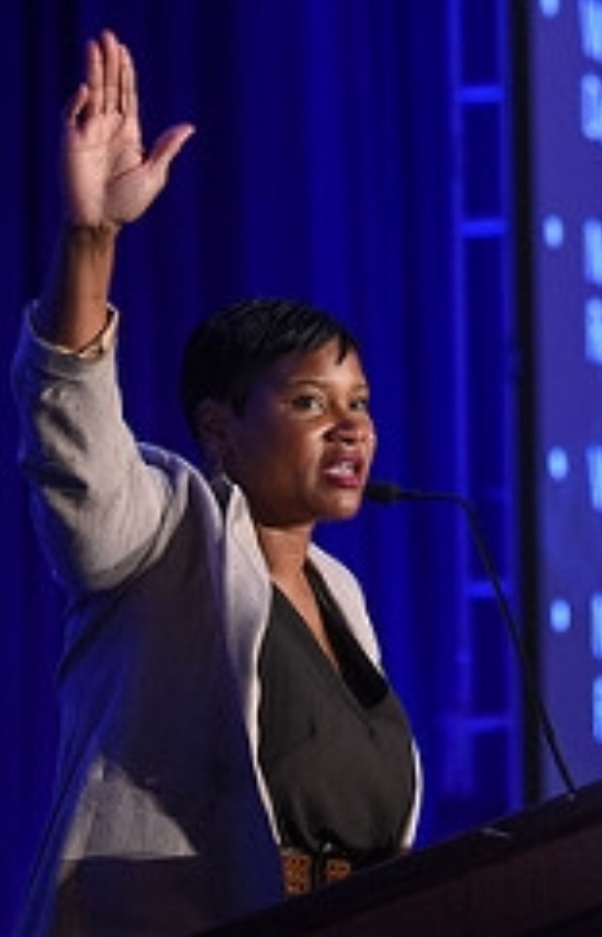
Roxanne Brown: USW Legislative Director
Roxanne was one of the Directors that put on this conference for our union. She also works side by side with the International President to make better legislation for union labor.

Slide 7
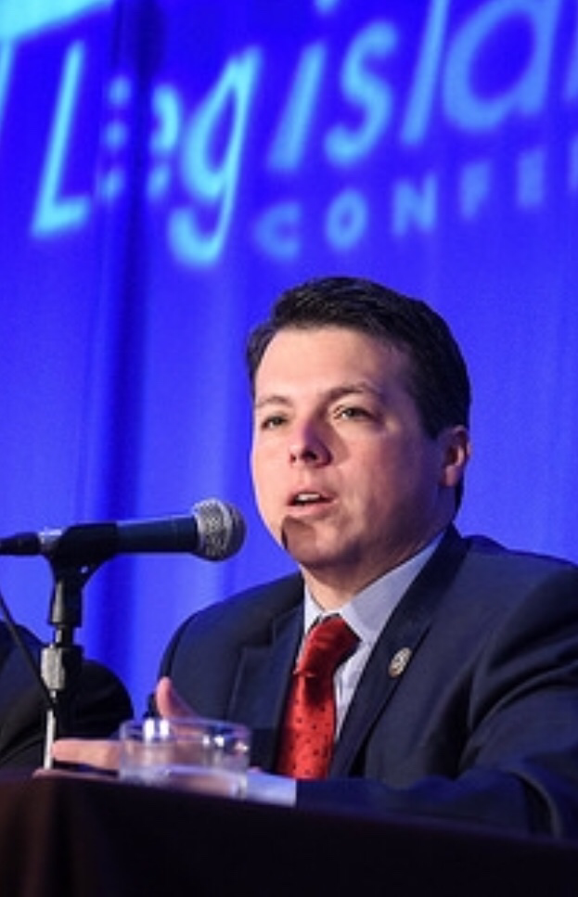
Brendan Boyle: United States Representative
Brendan is part of the blue collar caucus. He explained that the majority of workers are blue collar, and how inflation and the value of the dollar is paying people less than the last generation was paid.

Slide 8
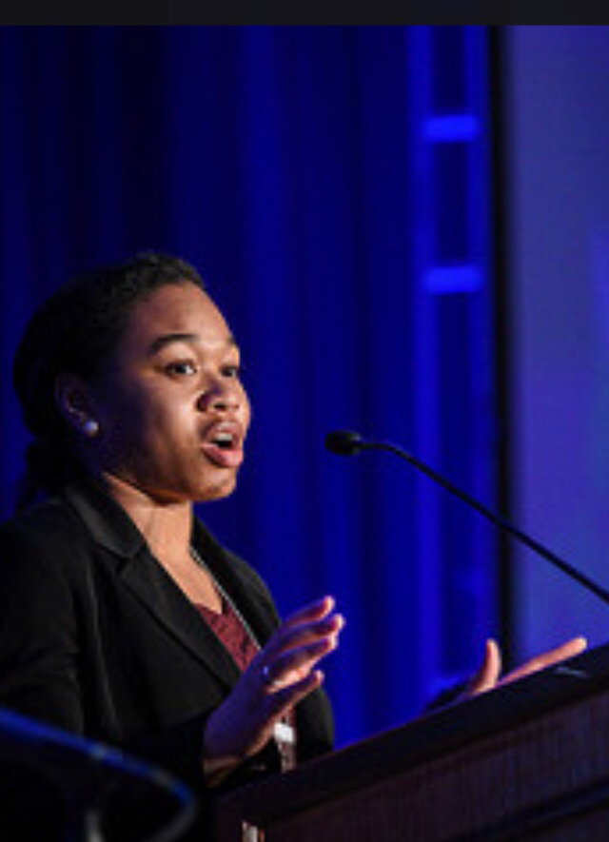
Jasmine Jefferson: Social Security Works
Jasmine explained that without a defined pension or a match on your 401k, you do not have a safe pension plan. Also that Social Security is in jeopardy because of the rich not paying their part. Cap at 118,500 6.2%

Slide 9
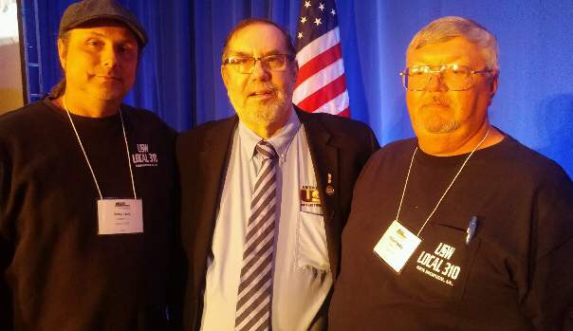
Leo Gerard: International President
Leo said that although the United Steelworkers are a very small part of the working people, we are the 800 pound gorilla at the Capitol because of our hard work in legislation.

Slide 10
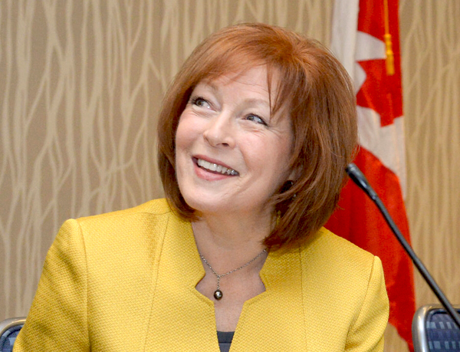
Holly Hart: USW Assistant To The President
She explained that the bad trade bill has killed 70,000 factory jobs since the 1990’s and moved them to Mexico. This has hurt the U.S. and Mexico. NAFTA needs to be fixed but not dissolved. Dumping products laws in the U.S. need fixed.

Slide 11
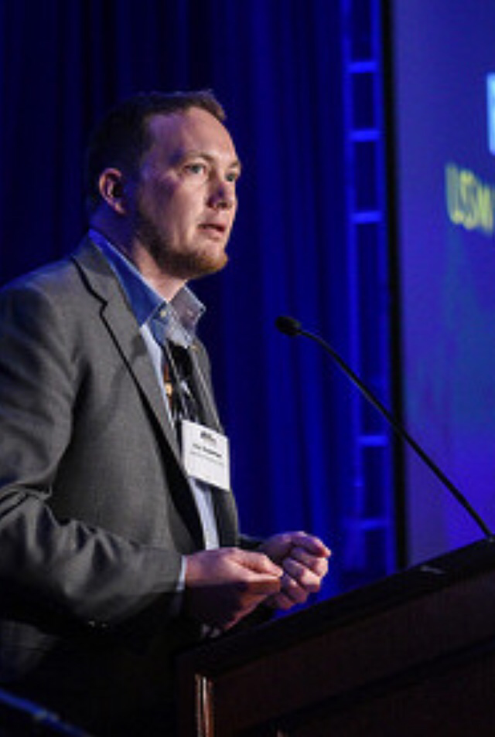
Work Shop 1: Delays And Rollbacks
This workshop taught us that regulations can provide critical protection to workers’ health and safety, also that it can take up to 30 years to get bills through legislation to protect these workers. Examples: asbestos and silica.
Roy Houseman

Slide 12
Work Shop 2: Working To Live, Or Living To Work?
There are no federal laws after the age of 16 about long work hours, except for truck drivers and airlines. We talked about needing to get bills passed that protect us from mandatory overtime, predictive scheduling, and on-call time. Without these protections, people work long hours which can cause injuries, death, and less family time.

Slide 13
Work Shop 3: A Deep Dive Into Trade
We talked about how in the last 20+ Year’s 70,000 factories have closed. Since 2001 Steelworkers have taken on 80 trade cases and only lost 6. Tools to fight back on bad trade: Anti-dumping, trade enforcement, and tariffs. (Explain dumping)

Slide 14
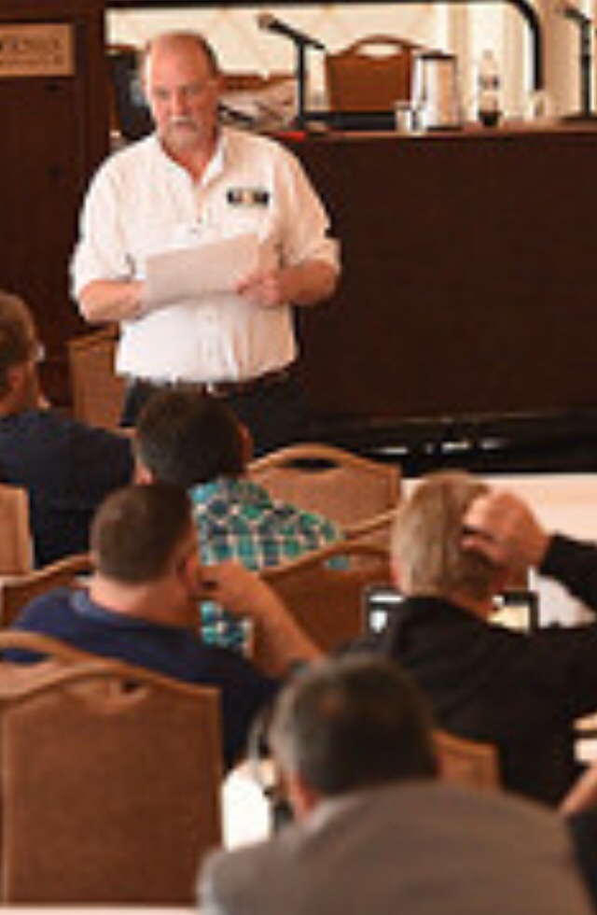
Work Shop 4: Every Vote Counts
We learned that only 55.7% of people voted in the last election. In the recent years the legislation has made it more difficult for people to vote. Ideas to get people registered: send out registration forms at age 18, be able to register the day of, and be able to register at work.
Bob Ryan

Slide 15
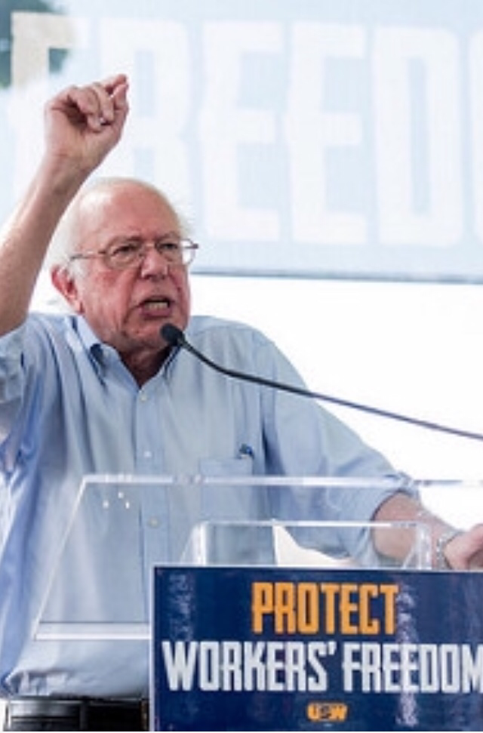
Rally At The Capitol
Several labor friendly legislators came to speak at the rally to encourage us for our day at the Capitol lobbying for our livelihood.

Slide 16
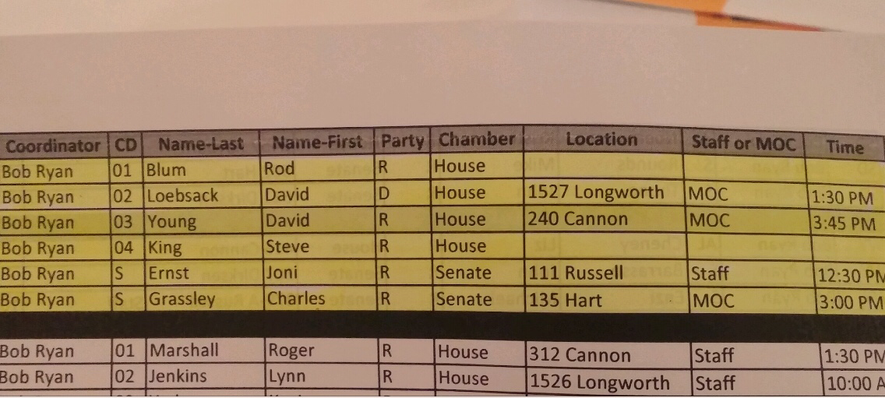
Lobby Day At The Capitol

Slide 17
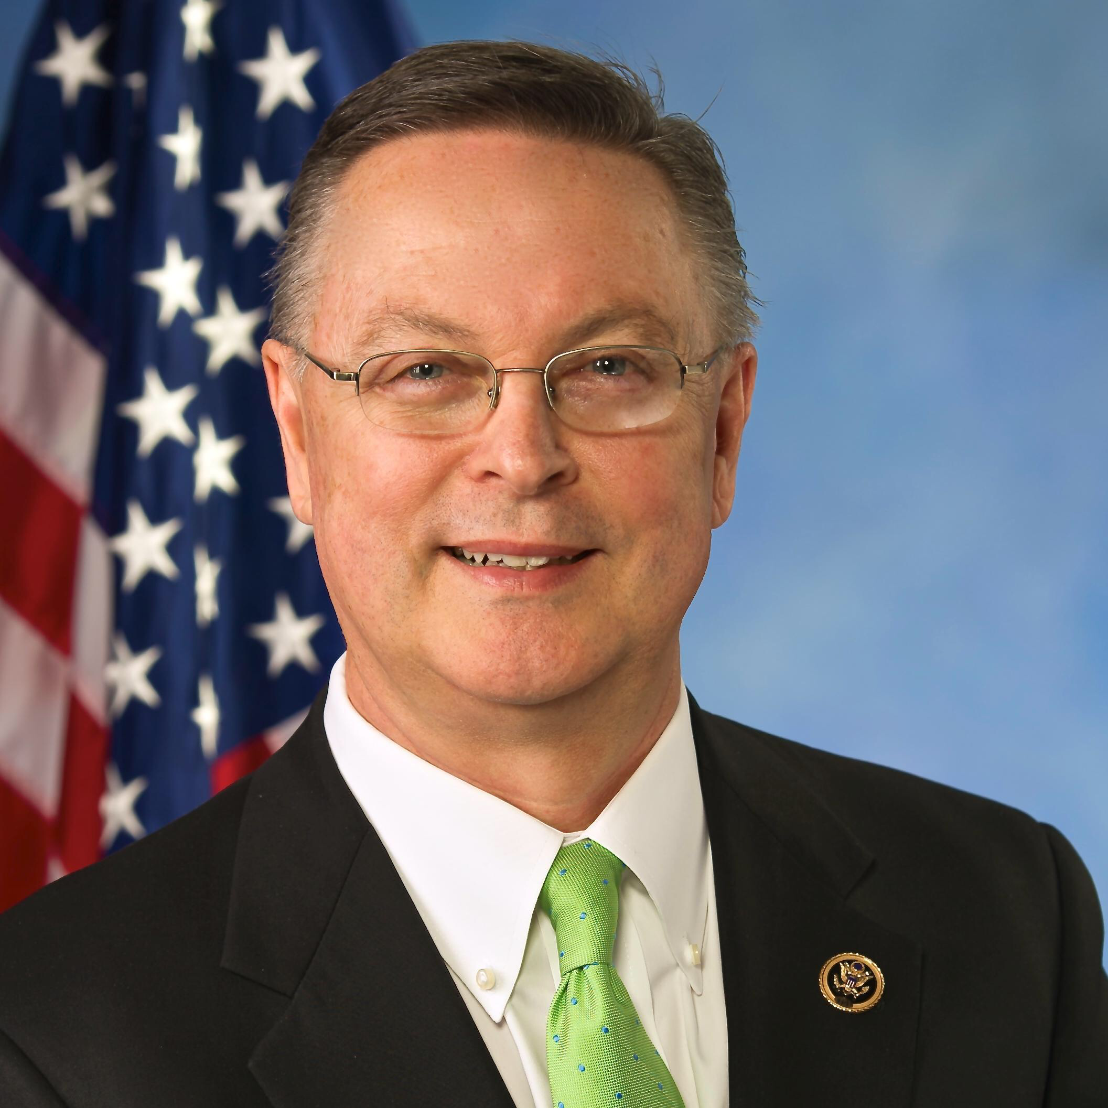
Rod Blum: House Republican
Would not meet with us, we left him a Steelworker packet.

Slide 18
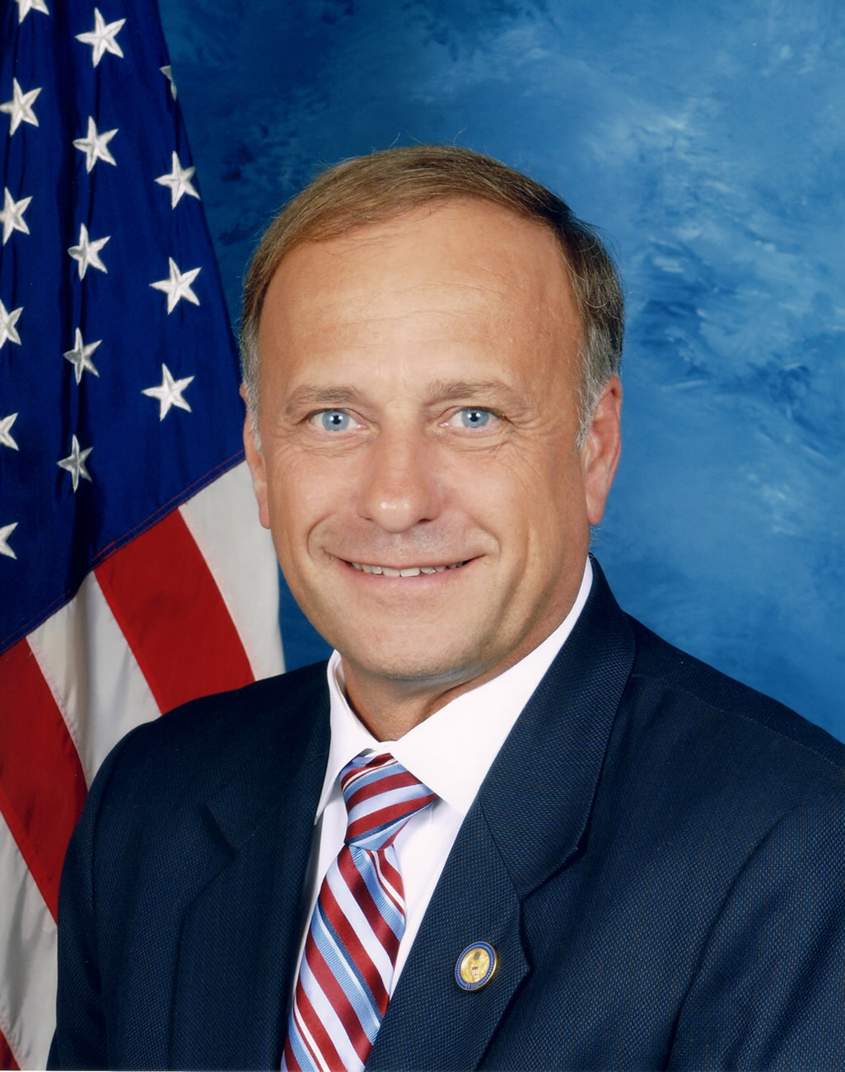
Steve King: House Republican
Would not meet with us, we left him a Steelworker packet.

Slide 19
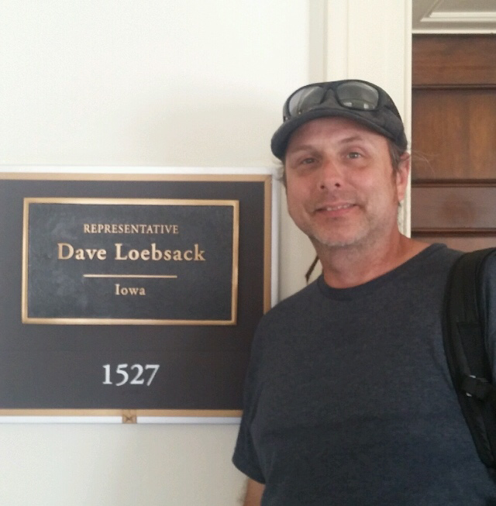
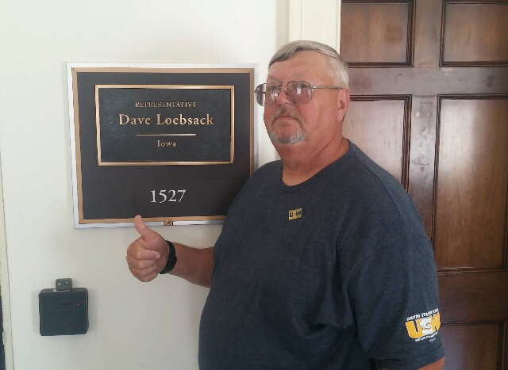
David Loebsack: House Democrat
We met with him and talked about dumping laws, Social Security, and the Paper Act. The Paper Act is importing paper and only saving 1-2 cents per paper. And he agreed all these things need to be addressed in our favor.

Slide 20
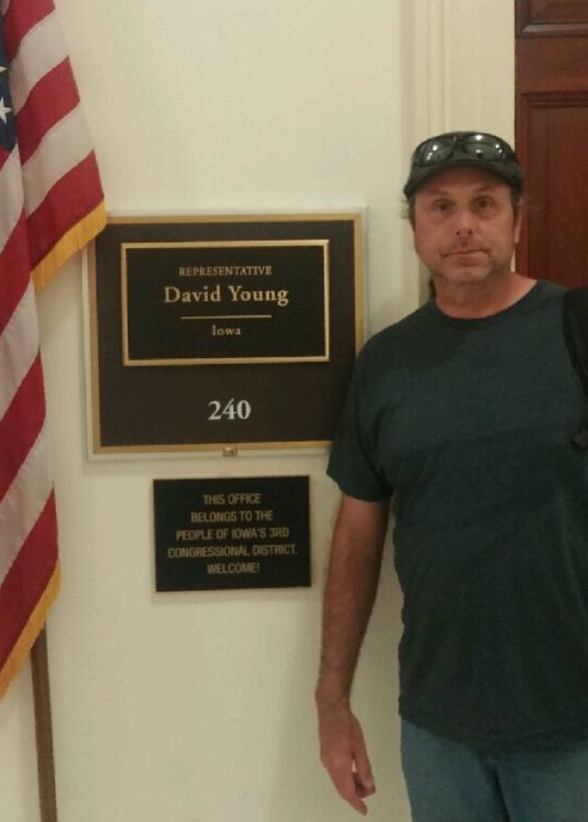
David Young: House Republican
He did not meet with us but his staff did, we talked about the same things and the staff said they would give him the information.

Slide 21
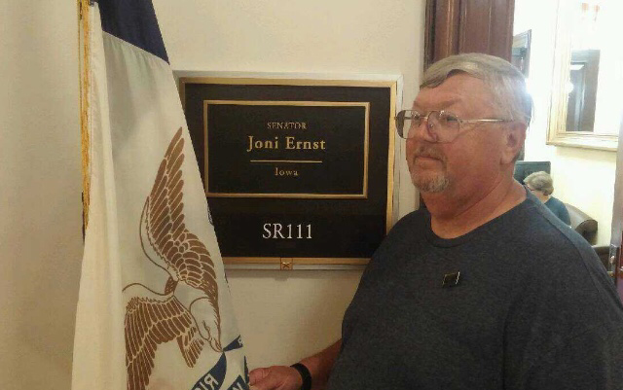
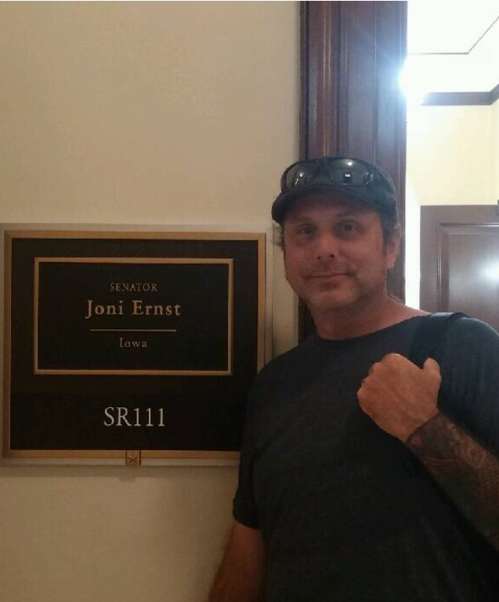
Joni Ernst: Senate Republican
She did not meet with us but her staff did. We talked about the same things and the staff said they would give her the information.

Slide 22
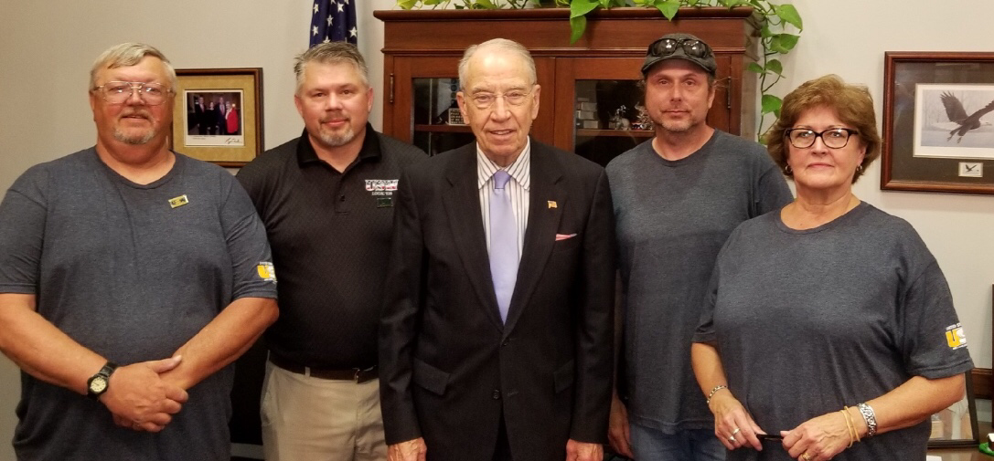
Charles Grassley: Senate Republican
He met with us and we talked about the same thing. He thought that our idea about Social Security would work but would not fix the whole problem. He said anti-dumping laws need to be fixed and that the paper law would not make it through legislation.

Slide 23
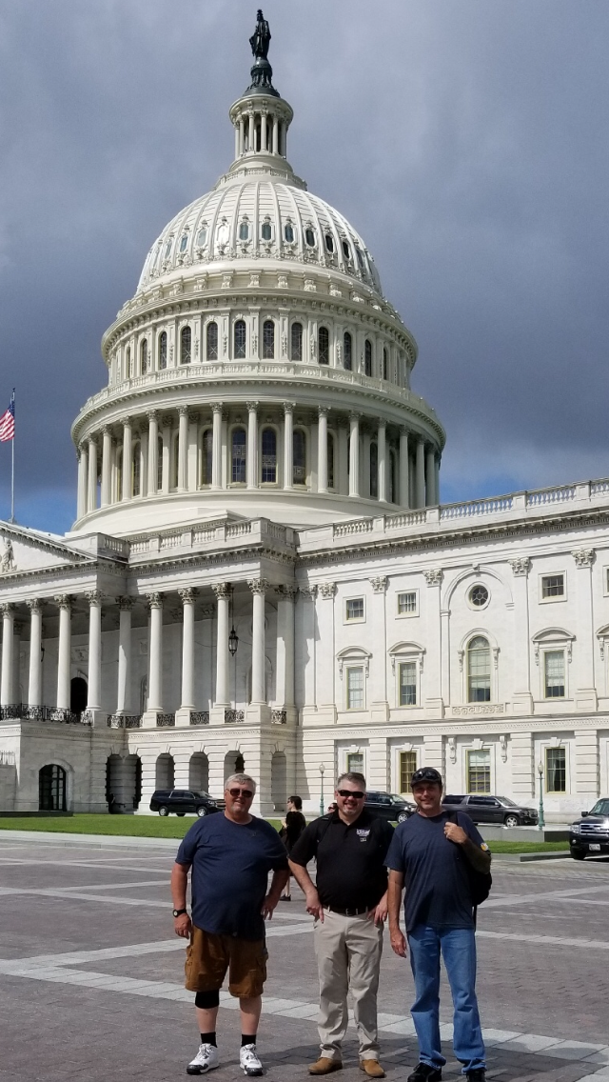
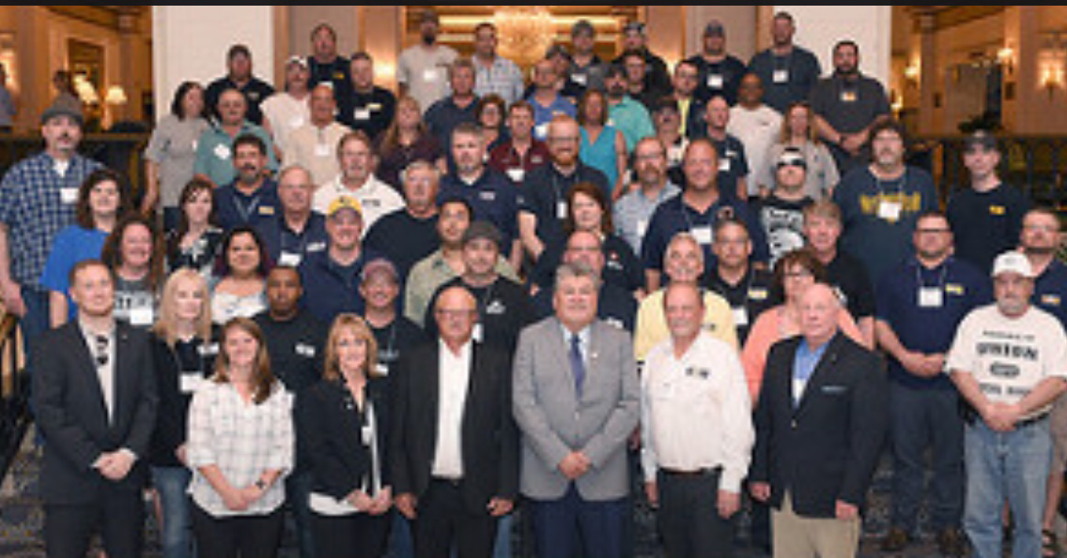
What I Learned
Labor legislation needs to improve so that labor can grow, and it is going to have to be done in a bipartisan way. I feel that several people in legislation feel the same way.

Slide 24


